Slide 1



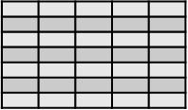






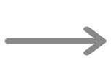
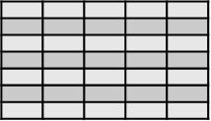



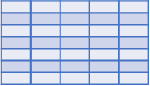





EMR Data
Sources
Schema
Acquisition
Semantically Enriched
Sentence Generation
Schema Map Generation
EMR₁
EMR Schema
Schema Attribute
att₁
Semantic Enriched Sentences
att₂
.
.
.
att_{n}
EMR₂
Similarity
Matching
att₁
0 0 0 1 0 0 0 0 0 0 0 0 0 0
att₂
.
.
.
Context vectors₁
att_{n}
Data Instances
Suffix Arrays
EMR₃
0 0 0 0 0 0 1 0 0 0 0 0 0 0
att₁
Context vectors₂
att₂
.
.
.
att_{n}
Embedded Vectors Generations
EMR₄
att₁
Attribute to Sentence Transformation
att₂
.
.
.
att_{n}
EMR_{n}
Terminological
Standard Dictionaries
(UMLS , SNOMED-CT or LONICS)
att₁
att₂
Resultant Sentence
A Consolidated and Interoperable Data
.
.
.
att_{n}

Slide 2
Backward Suffix Array
Forward Suffix Array
Regex based Suffix Generation
String S
d | a | t | e | O | f | A | d | m | i | s | s | i | o | n
d | a | t | e | O | f | A | d | m | i | s | s | i | o | n
d | a | t | e | O | f | A | d | m | i | s | s | i | o | n
Suffix(1)
d | a | t | e | O | f | A | d | m | i | s | s | i | o | n
d | a
Suffix(2)
a | t | e | O | f | A | d | m | i | s | s | i | o | n
d | a | t
Suffix(3)
t | e | O | f | A | d | m | i | s | s | i | o | n
d | a | t | e
d | a | t | e
Suffix(4)
e | O | f | A | d | m | i | s | s | i | o | n
d | a | t | e | O
Suffix(5)
O | f | A | d | m | i | s | s | i | o | n
d | a | t | e | O | f
O | f
Suffix(6)
f | A | d | m | i | s | s | i | o | n
d | a | t | e | O | f | A
Suffix(7)
A | d | m | i | s | s | i | o | n
d | a | t | e | O | f | A | D
A | d | m | i | s | s | i | o | n
Suffix(8)
d | m | i | s | s | i | o | n
d | a | t | e | O | f | A | d | m
Suffix(9)
m | i | s | s | i | o | n
d | a | t | e | O | f | A | d | m | i
Suffix(10)
i | s | s | i | o | n
d | a | t | e | O | f | A | d | m | i | s
Suffix(11)
s | s | i | o | n
d | a | t | e | O | f | A | d | m | i | s | s
Suffix(12)
s | i | o | n
d | a | t | e | O | f | A | d | m | i | s | s | i
Suffix(13)
i | o | n
d | a | t | e | O | f | A | d | m | i | s | s | i | o
Suffix(14)
o | n
d | a | t | e | O | f | A | d | m | i | s | s | i | o | n
Combined Suffix Array
d | a | t | e | O | f | A | d | m | i | s | s | i | o | n
Final Output by combing three suffix array
d | a
a | t | e | O | f | A | d | m | i | s | s | i | o | n
d | a | t
t | e | O | f | A | d | m | i | s | s | i | o | n
d | a | t | e
e | O | f | A | d | m | i | s | s | i | o | n
d | a | t | e | O
O | f | A | d | m | i | s | s | i | o | n
d | a | t | e | O | f
f | A | d | m | i | s | s | i | o | n
d | a | t | e | O | f | A
A | d | m | i | s | s | i | o | n
d | a | t | e | O | f | A | d
O | f
d | m | i | s | s | i | o | n
d | a | t | e | O | f | A | d | m
m | i | s | s | i | o | n
d | a | t | e | O | f | A | d | m | i
i | s | s | i | o | n
d | a | t | e | O | f | A | d | m | i | s
s | s | i | o | n
d | a | t | e | O | f | A | d | m | i | s | s
s | i | o | n
d | a | t | e | O | f | A | d | m | i | s | s | i
i | o | n
d | a | t | e | O | f | A | d | m | i | s | s | i | o
o | n
d | a | t | e | O | f | A | d | m | i | s | s | i | o | n

Slide 3
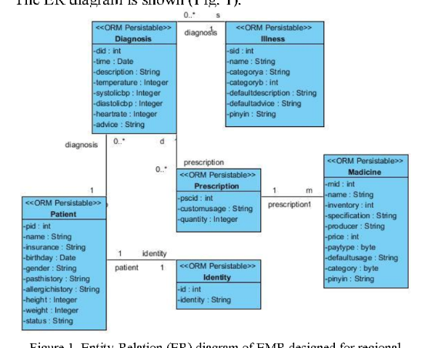
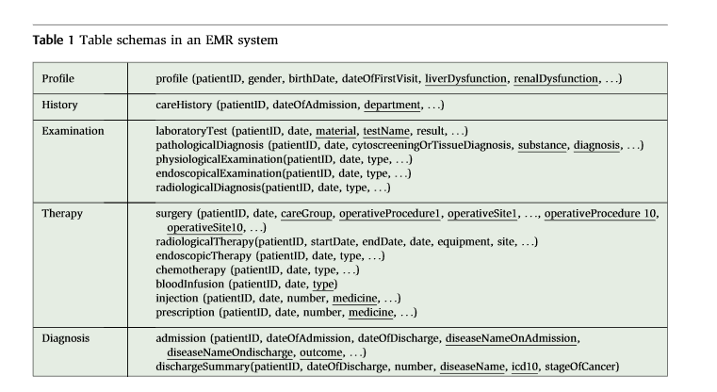
OpenEMR Reports
Demographics
openemr_MedicalProblems
Title
Coding
BeginDate
EndDate
Occurrence
ReferredBy
Outcome
Destination
AdmissionsCorePopulatedTable
PatientID
AdmissionID
AdmissionStartDate
AdmissionEndDate
Name
ExternalID
DOB
Sex
SS
License
MaritalStatus
UserDefined
BillingNote
Address
City
State
PostalCode
Country
MotherName
EmergencyContact
EmergencyPhone
HomePhone
WorkPhone
MobilePhone
ContactEmail
TrustedEmail
Provider
Referring_Provider
Pharmacy
HIPPANoticeReceived
AllowVoiceMessage
LeaveMessageWith
AllowMailMessage
AllowSMS
AllowEmail
AllowImmunizationRegistryUse
AllowImmunizationInfoSharing
AllowHeartInformationExchange
AllowPatientPortal
CareTeam
CMSPortalLogin
ImmunizationRegistryStatus
ImmunizationRegistryStatusEffectiveDate
PublicityCode
PublicityCodeEffectiveDate
ProtectionIndicator
ProtectionIndicatorEffectiveDate
Language
Race
Ethnicity
FamilySize
FinancialReviewDate
Homeless
MonthlyIncome
Interpreter
MigrantSeasonal
VFC
Religion
DateDecreased
ReasonDecreased
PatientCorePopulatedTable
PatientID
PatientGender
PatientDateOfBirth
PatientRace
PatientMaritalStatus
PatientLanguage
PatientPopulationPercentageBelowPoverty
PatientName
tblPatient
PatientID
PatientMRNNo
PatientName
DateOfBirth
Age
Gender
SymptomsAndSigns
ClinicalHistory
PhysicalExam
ECG
NTproBNP
BNP
LVEF
LAVI
LVMI
Ee
eSeptal
LongitudinalStrain
TRV
EncounterDate
LabsCorePopulatedTable
PatientID
AdmissionID
LabName
LabValue
LabUnits
LabDateTime
openemr_Prescriptions
PatientId
PatientName
Add
EndDate
Occurrence
ReferredBy
Outcome
Destination
AdmissionsDiagnosesCorePopulatedTable
PatientID
AdmissionID
PrimaryDiagnosisCode
PrimaryDiagnosisDescription
Krsiloemr
EMRBOTS.org
https://www.researchgate.net/publication/224101596_MedTAKMI-CDI_Interactive_knowledge_discovery_for_clinical_decision_intelligence
https://www.semanticscholar.org/paper/Design-a-novel-electronic-medical-record-system-for-Pan-Fu/f38d8a1a5468e1501a124766fc3b48119628f72d/figure/0

Slide 4
Patient
Diagnosis
Illness
Medicine
pid
name
insurance
birthday
gender
pasthistory
allergichistoy
height
weight
status
did
time
description
temperature
systoilicbp
diastolicbp
heartrate
advice
sid
name
categorya
categoryb
defaultdescription
defaultadvice
pinyin
mid
name
invetory
specification
producer
price
paytype
defaultusage
category
pinin
Prescription
Identity
pscid
customusage
quantity
id
identity
https://www.semanticscholar.org/paper/Design-a-novel-electronic-medical-record-system-for-Pan-Fu/f38d8a1a5468e1501a124766fc3b48119628f72d/figure/0

Slide 5
CareHistory
Examination (laboratoryTest)
patientID
DateOfAdmissioin
department
patientID
date
material
testName
result
Profile
patientID
gender
birthDate
dateOfFirstVisit
LiverDysfunction
RenalDysfunction
Therapy (surgery)
Diagnosis (admission)
patientID
date
careGroup
operativeProcedure1
operativeStie1
patientID
dateOfAdmission
dateOfDischarge
diseaseNameOnAdmission
diseaseNameOnDischarge
outcome
https://www.researchgate.net/publication/224101596_MedTAKMI-CDI_Interactive_knowledge_discovery_for_clinical_decision_intelligence

Slide 6
L.Pan EMR
MedTAKMI-CDI EMR
Patient
Diagnosis
Illness
Medicine
Profile
Therapy (surgery)
Diagnosis (admission)
pid
name
insurance
birthday
gender
pasthistory
allergichistoy
height
weight
status
did
time
description
temperature
systoilicbp
diastolicbp
heartrate
advice
sid
name
categorya
categoryb
defaultdescription
defaultadvice
pinyin
mid
name
invetory
specification
producer
price
paytype
defaultusage
category
pinin
patientID
gender
birthDate
dateOfFirstVisit
LiverDysfunction
RenalDysfunction
patientID
date
careGroup
operativeProcedure1
operativeStie1
patientID
dateOfAdmission
dateOfDischarge
diseaseNameOnAdmission
diseaseNameOnDischarge
outcome
CareHistory
laboratoryTest
patientID
DateOfAdmissioin
department
patientID
date
material
testName
result
Prescription
Identity
pscid
customusage
quantity
id
identity
Kr Silo EMR
tblPatient
PatientID
PatientMRNNo
PatientName
DateOfBirth
Age
Gender
SymptomsAndSigns
ClinicalHistory
PhysicalExam
ECG
NTproBNP
BNP
LVEF
LAVI
LVMI
Ee
eSeptal
LongitudinalStrain
TRV
EncounterDate
Notes:
6

Slide 7
OpenEMR Reports
EMRBOTS
Demographics
openemr_
MedicalProblems
openemr_
Prescriptions
AdmissionsCore
PopulatedTable
PatientCore
PopulatedTable
LabsCorePopulated
Table
Name
ExternalID
DOB
Sex
SS
License
MaritalStatus
UserDefined
BillingNote
Address
City
State
PostalCode
Country
MotherName
EmergencyContact
EmergencyPhone
HomePhone
WorkPhone
MobilePhone
ContactEmail
TrustedEmail
Provider
Referring_Provider
Pharmacy
HIPPANoticeReceived
AllowVoiceMessage
LeaveMessageWith
AllowMailMessage
AllowSMS
AllowEmail
Title
Coding
BeginDate
EndDate
Occurrence
ReferredBy
Outcome
Destination
PatientId
PatientName
Add
EndDate
Occurrence
ReferredBy
Outcome
Destination
PatientID
PatientGender
PatientDateOfBirth
PatientRace
PatientMaritalStatus
PatientLanguage
PatientPopulationPercentageBelowPoverty
PatientName
PatientID
PatientGender
PatientID
AdmissionID
LabName
LabValue
LabUnits
LabDateTime
PatientID
AdmissionID
AdmissionStartDate
AdmissionEndDate
AdmissionsDiagnoses
CorePopulatedTable
PatientID
AdmissionID
PrimaryDiagnosisCode
PrimaryDiagnosisDescription

Slide 8
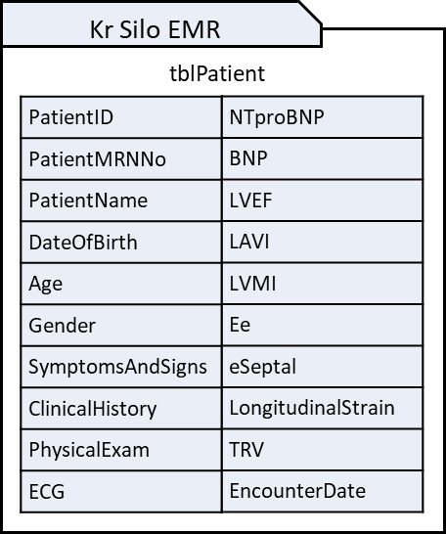
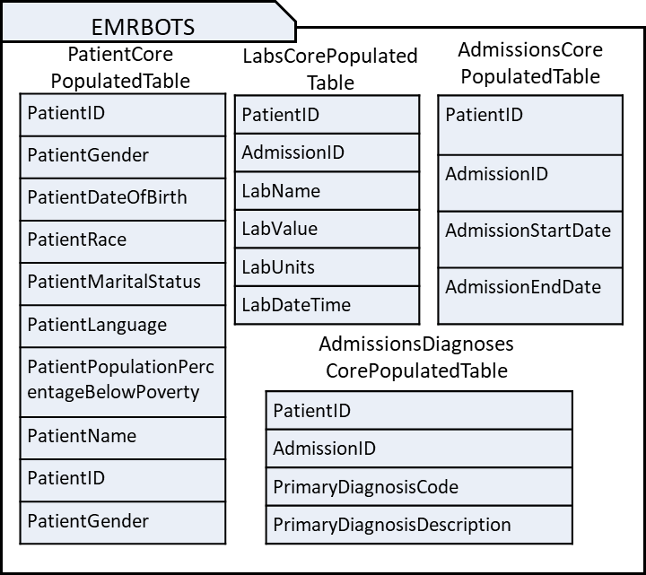
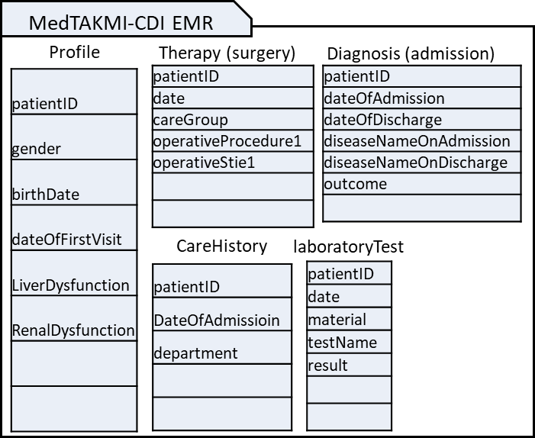
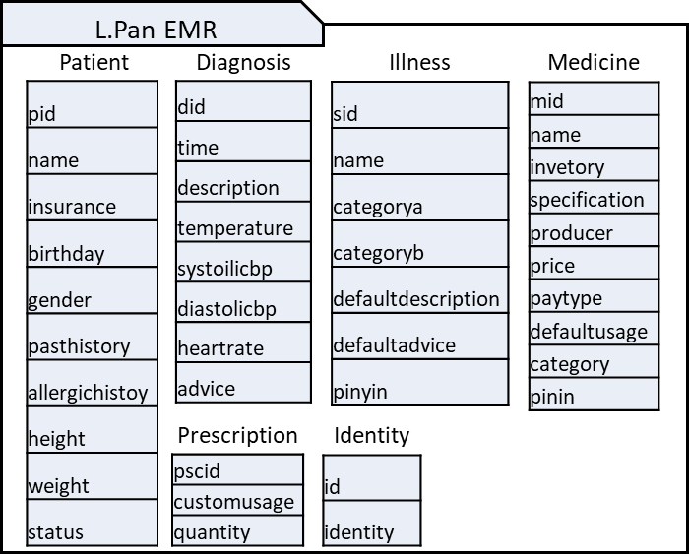
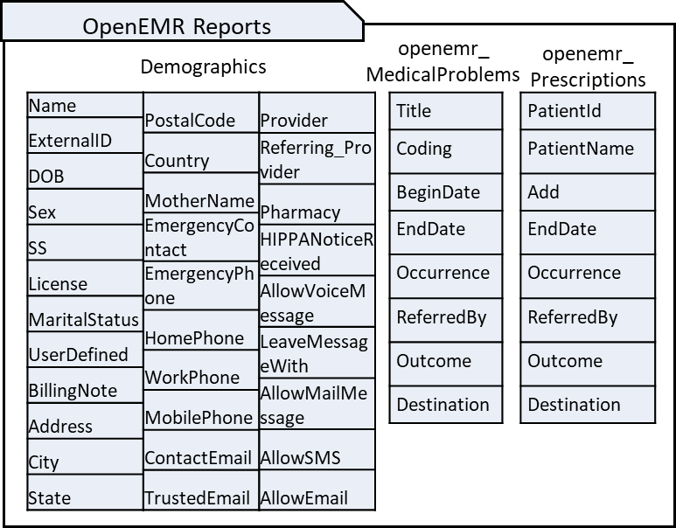
Notes:
8

Slide 9
s₁
s₂
s₃
s₄
s₅

Slide 10

Load schema
and data
No
Table Exist?
End
Yes
No
Attribute
Exist?
Generate
Suffix Array
Suffix Exist?
No
Generate Enriched
Sentence
Yes
UMLS
Dictionary
Get Suffix
Semantic Types
Yes
Semantic Type
== None
No
Append Semantic
Types to Suffix
Notes:
10

Slide 11
EMRBots.
PatientCorePopulatedTable.
PatientDateOfBirth
OpenEMR.
Demographics.
DOB
Schema 1
Schema 2
Syntactic Context Identifier
Schema Name, Table Name, Attribute Name
Syntactic Context Identifier
Schema Name, Table Name, Attribute Name
Schema: EMRBots
Table: PatientCorePopulatedTable Attribute: PatientDateOfBirth
Schema: OpenEMR
Table: Demographics
Attribute: DOB
Semantic Identifier
Attribute semantically enriched suffix tree
Semantic Identifier
Attribute semantically enriched suffix tree
Schema: EMRBots
Table: PatientCorePopulatedTable Attribute: PatientDateOfBirth
Suffix Tree:
Schema: OpenEMR
Table: Demographics
Attribute: DOB
Suffix Tree:
Similarity Matcher
Similarity score
Similarity
Score > X
Similar
Dissimilar
Notes:
11

Slide 13
Attribute Context
Schema Name | Table Name | Attribute Name
Schema Version | Source | Recorded Date
Attribute Type
Data Type | Possible Value
Attribute Semantics
Suffix Array | Concept Array
Notes:
13

Slide 14
IF (True)
THEN True
Except
IF AttributeType = ‘string’
THEN False
If not
IF AttributeType = ‘long’
THEN False
If not
IF AttributeType ⬄ ‘long’
THEN False
Except
Except
Except
Except
IF SemanticType = ‘ST₁’
THEN ‘Concept₁’
IF SemanticType = ‘ST₂’
THEN ‘Concept₂’
IF SemanticType = ‘ST₁’
THEN ‘Concept₇’
IF SemanticType = ‘ST₁’
THEN ‘Concept₁’
Except
Except
Except
Except
Except
Except
IF SemanticType = ‘ST₃’
THEN ‘Concept₃’
IF SemanticType = ‘ST₄’
THEN ‘Concept₄’
IF SemanticType = ‘ST₅’
THEN ‘Concept₅’
IF SemanticType = ‘ST₆’
THEN ‘Concept₆’
IF SemanticType = ‘ST₇’
THEN ‘Concept₇’
IF SemanticType = ‘ST₈’
THEN ‘Concept₈’
Notes:
14

Slide 15
Example
IF (True)
THEN Class ‘0’
Except
IF AttributeType = ‘string’
THEN False
If not
IF AttributeType ⬄ ‘integer’
THEN False
Except
Except
Except
IF SemanticType = ‘Patient or Disabled Group’
THEN ‘Patient’
IF SemanticType = ‘Findings’
THEN False
IF SemanticType = ‘Disease’
THEN False
Except
Except
Except
Except
Except
IF = ‘Intellectual Product’ THEN ‘PatientName’
IF SemanticType = ‘Organism Attribute’
THEN ‘PatientGender’
IF Schema = ‘s1’ AND Key = ‘Diabetes’
THEN ‘0001’
IF Schema = ‘s2’ AND Key = ‘Glucose’
THEN ‘0001’
IF Schema = ‘s1’ AND Key = ‘XYZ’
THEN ‘0001’

Slide 16
Example
IF (True)
THEN Class ‘0’
Except
IF AttributeType = Integer
THEN False
If not
IF AttributeType = Categorical
THEN False
Except
Except
Except
IF SemanticType = ‘Disease’
THEN False
IF SemanticType = ‘Findings’
THEN False
IF SemanticType = ‘Disease’
THEN False
Except
Except
Except
Except
Except
IF Schema = ‘s1’ AND Key = ‘Diabetes’
THEN ‘0001’
IF Schema = ‘s2’ AND Key = ‘Glucose’
THEN ‘0001’
IF Schema = ‘s1’ AND Key = ‘Diabetes’
THEN ‘0001’
IF Schema = ‘s2’ AND Key = ‘Glucose’
THEN ‘0001’
IF Schema = ‘s1’ AND Key = ‘XYZ’
THEN ‘0001’

Slide 20


